Slide 1
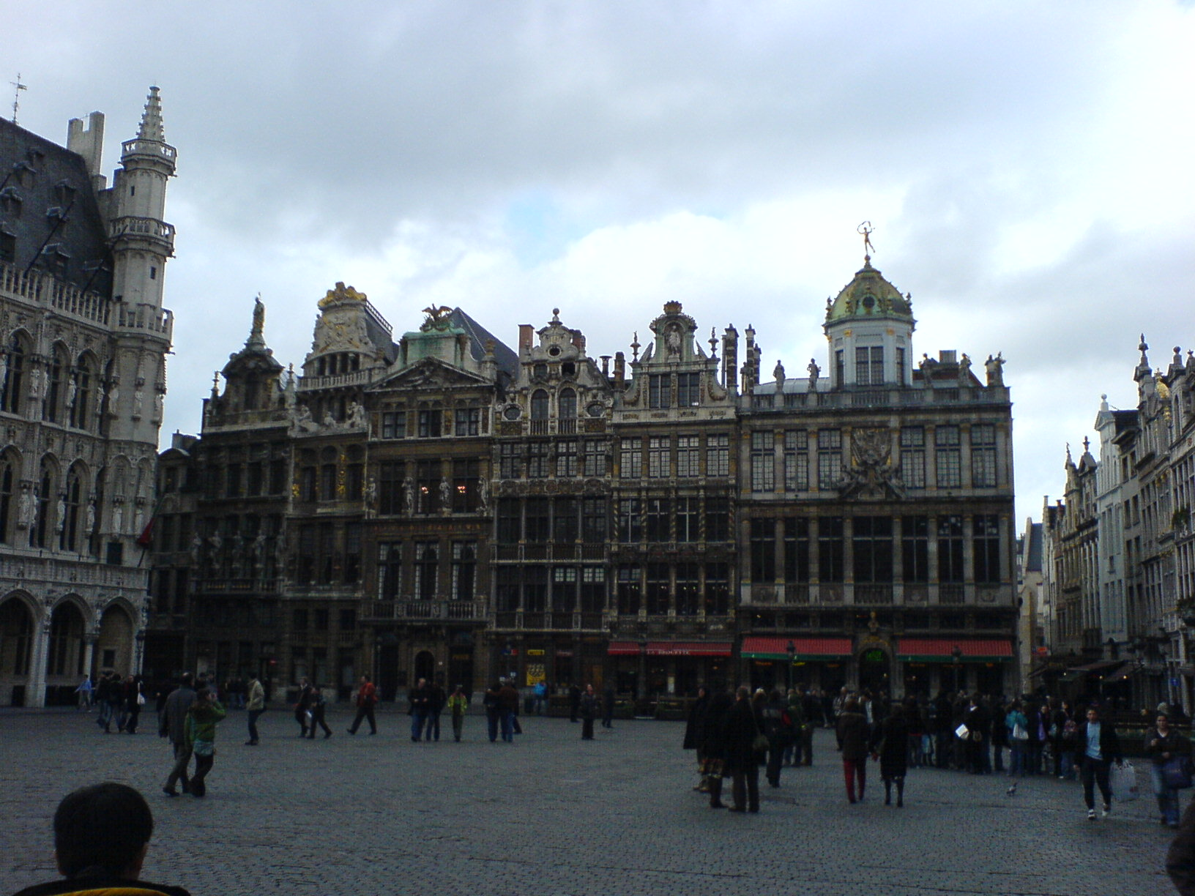
FOSDEM 2007: Friday
Richard Dawe, Birmingham Perl Mongers, 28th March 2007
Beer Event
Sightseeing
Notes:
Left-hand photo is the Grand Place / Grote Markt in Brussels
The Beer Event was at the Roy d'Espagne pub/bar on the Grote Markt. There were so many FOSDEMers, it was hard to get into the place.

Slide 2
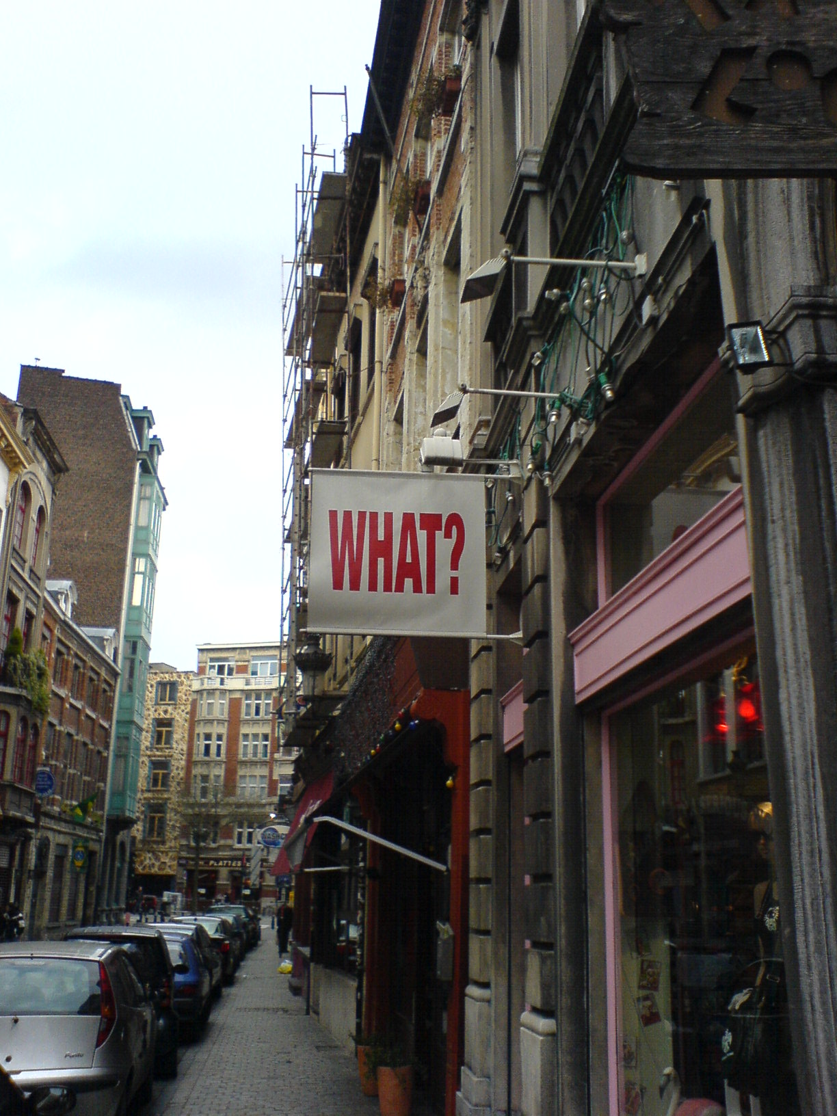
FOSDEM 2007: Saturday
Richard Dawe, Birmingham Perl Mongers, 28th March 2007
Sofware Patents
One Laptop Per Child
Libre Java
AIGLX
OpenMoko
No Perl :(
Notes:
OLPC: interesting hardware (see their website)
Sun hoping for free Java by March 2007. Some licensing problems with 3rd party libraries need solving before then. Next Java (7?) will be first version developed fully Free.
AIGLX was talking about the problems of accelerating X-Windows on both the local machine (direct) and over the network (indirect).
OpenMoko is a (99%) Free Software phone. GSM stack is not free – hidden in chip. 350 USD to buy.

Slide 3
FOSDEM 2007: Sunday
Richard Dawe, Birmingham Perl Mongers, 28th March 2007
Metasploit (AKA pwnage at 11 o'clock)
RPM Packaging
Mono progress report
GDB Tracepoints
Still no Perl :(
Notes:
Metasploit is an exploitation framework. Scary. Very glad I didn't have my laptop at that point.
RPM Packaging was about some suggestions of how to improve rpm packages. XAR. How to make it work better on Mac OS X or systems with pre-installed stuff.
Interesting performance and API-compatiblity improves in Mono recently. Entertaining talk (and heckles).
GDB Tracepoints are about how to capture snapshots of kernel state without stopping the kernel.

Slide 4
FOSDEM 2007: I Want More!
Richard Dawe, Birmingham Perl Mongers, 28th March 2007
http://www.fosdem.org/2007/schedule/days
Videos of two main tracks: http://www.fosdem.org/2007/media/video
OLPC: http://www.laptop.org/laptop/
http://wiki.openmoko.org/wiki/Introduction
eXtensible ARchiver (XAR): http://code.google.com/p/xar/

